Slide 1
ECE 180 Final Presentation
Team 10
Airline Recommendation System
Developers:
Bojian Xu
David Osuna
Youness Khallou
Jiaquan Chen
Jinyang Tang
Boyang Zhang
Fengjunyan Li

Slide 2

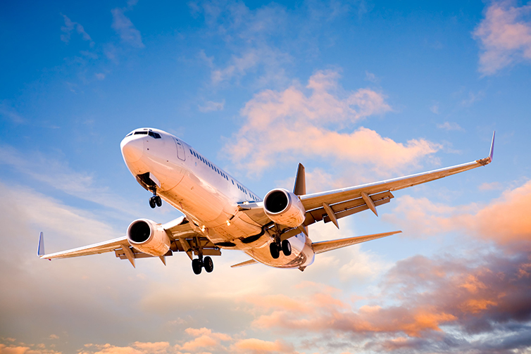
Airlines
Notes:
David’s Slide
Introduce the Topic:
*Have anyone miss a big conference meeting, a dream job interview , spending holiday with their loved ones because the flight is been delayed or canceled... Flight delay/cancellation is always been irritating not only to passengers but also to the airlines.
What is the problem ?
Who does the problem address to?
Have anyone miss a big conference meeting, a dream job interview , spending holiday with their loved ones because the flight is been delayed or canceled... Flight delay/cancellation is always been irritating not only to passengers but also to the airlines. Our

Slide 3
Research Question:
What are the delays caused by the operation of the airlines?
Types of Delay: Air Carrier; Weather; NAS; Late Aircraft; Security
How to reflect the airline’s delay performance?
Will the time of the year influence the airline’s performance?
Data Source: Bureau of Transportation Statistics (Jan 2012 - Dec 2017)
Notes:
Data source
What we have already
Delay type of interests

Slide 4
Data Analysis
Extract relevant data for target airlines and airports
Compute and sort airline’s delay performance
Results and visualizations
Matplotlib
GUI
Notes:
The data set includes all flight delays data from all domestic airline at all domestic airpo
Second Bullet Point: Explain how we will extract data from the data provided by the Bureau of transportation statistics
Third Bullet Point: Explain how we extracted the data to calculate the average time delay at certain times of the year.
Fourth Bullet Points: Data Science methodologies used to accomplish this project.

Slide 5
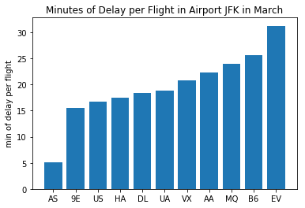
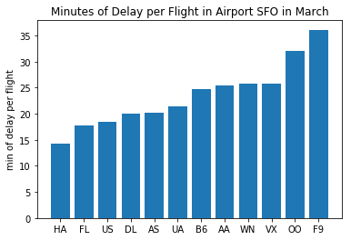
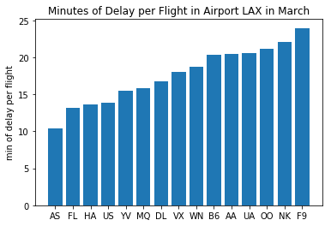
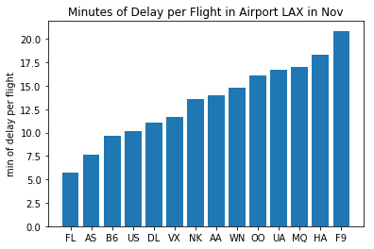
Airlines Performance in Major Domestic Airports
Notes:
Here are some results we have for a few major airports.
Quick comparison JFK SFO LAX
Few airlines generally perform well in many airports, also airport specific
The bottom two . AS performs well in both month. But for some other airlines, the difference is more obvious Delta 11 not only compareto itself but also to other airlines as well.

Slide 6
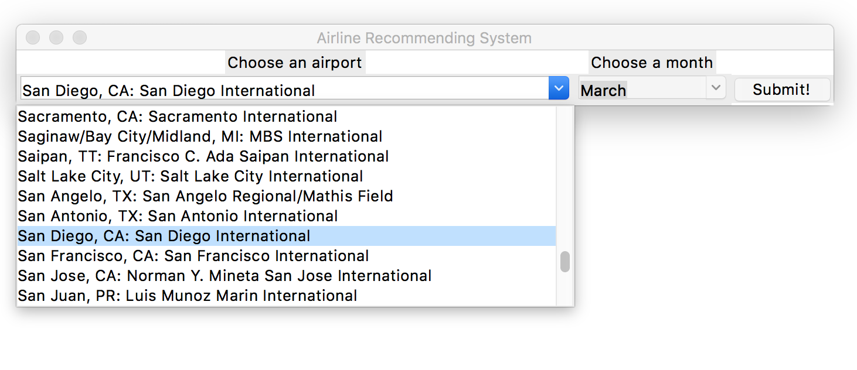
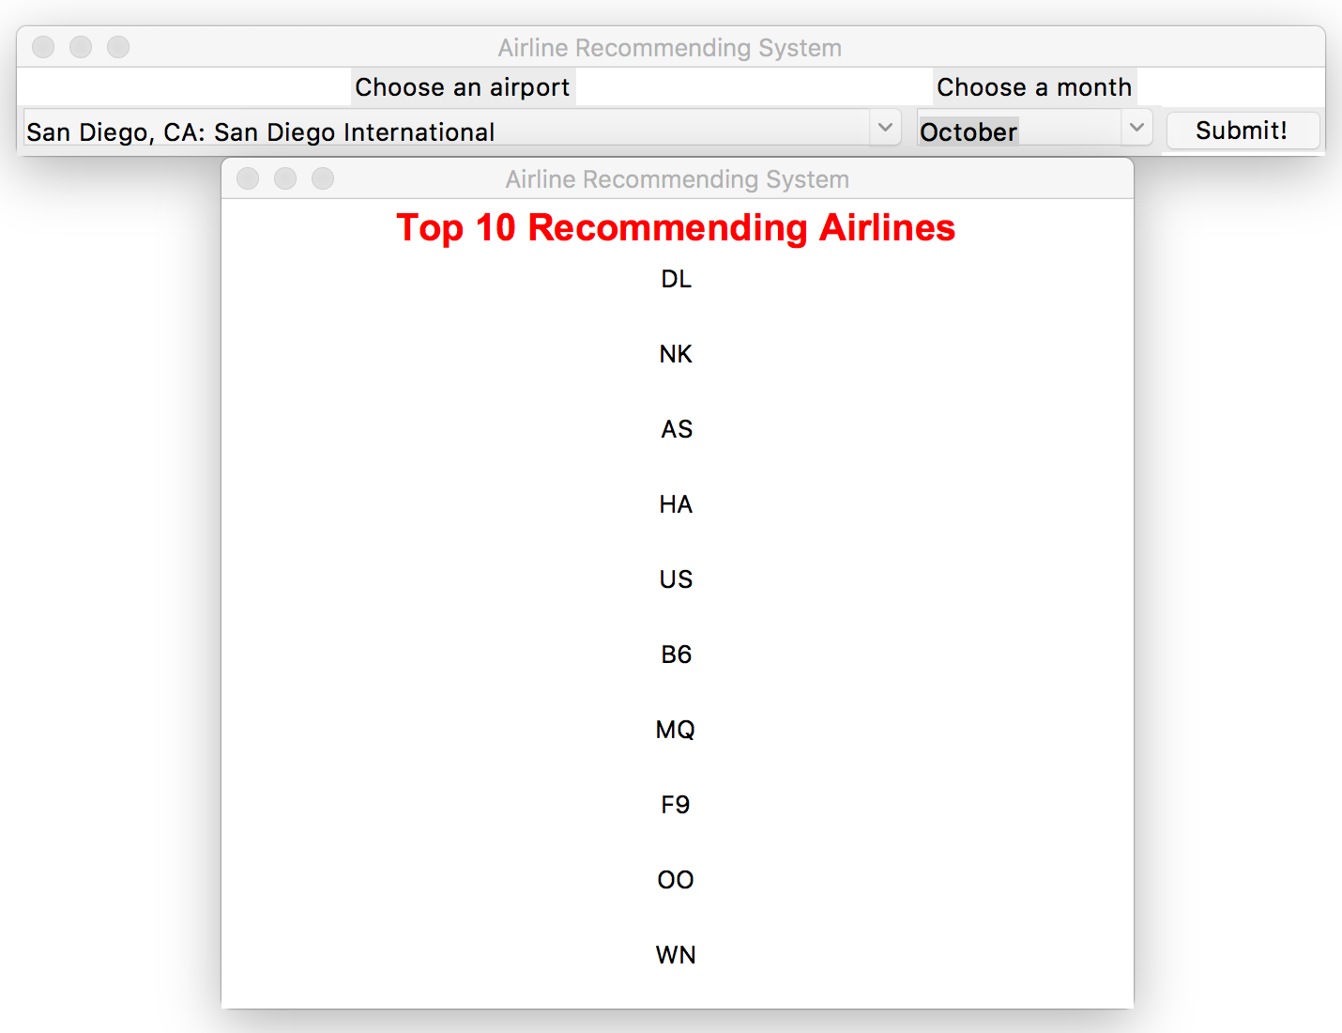
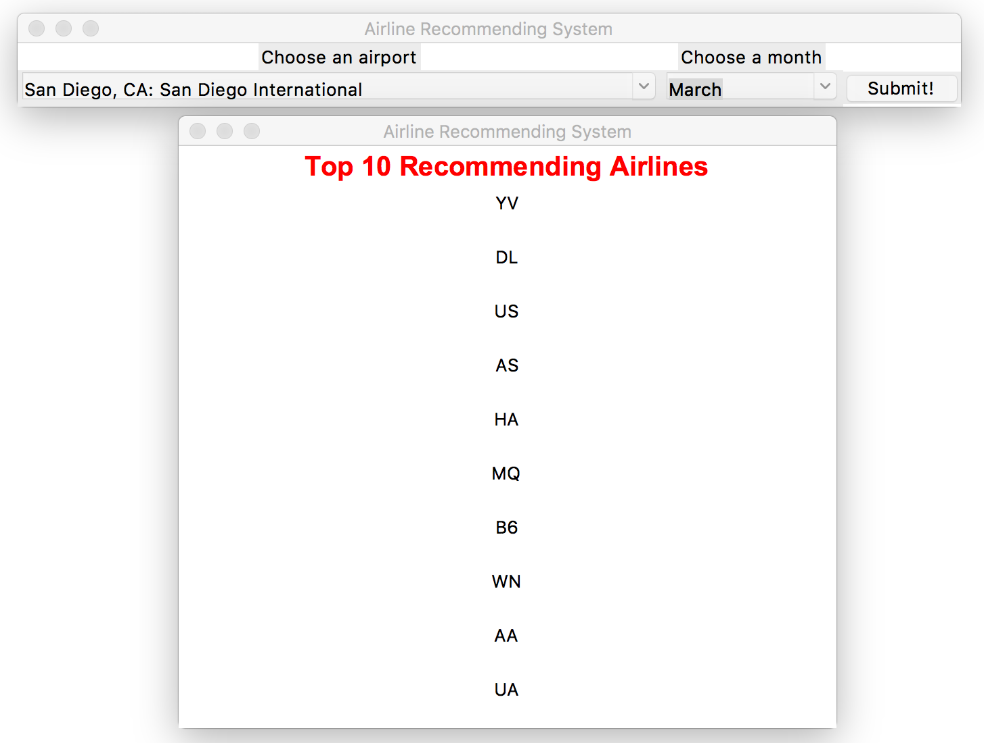
GUI Snapshot:
San Diego Airline Recommendation: Mar vs Oct
Notes:
In a click of a button. Our gui does exactly that. Input airport, month, top 10 performing airlines

Slide 7
Conclusion
What do we conclude from the project?
Airline performance
AS overall have the best performance in US airports in month of March
Final thoughts:
Future predictions & recommendations-provide the customers with better flight traveling experience
Convenience and efficacy-Easier and faster for the customers to choose flights.

Slide 8
Thanks
Any questions?

Slide 9
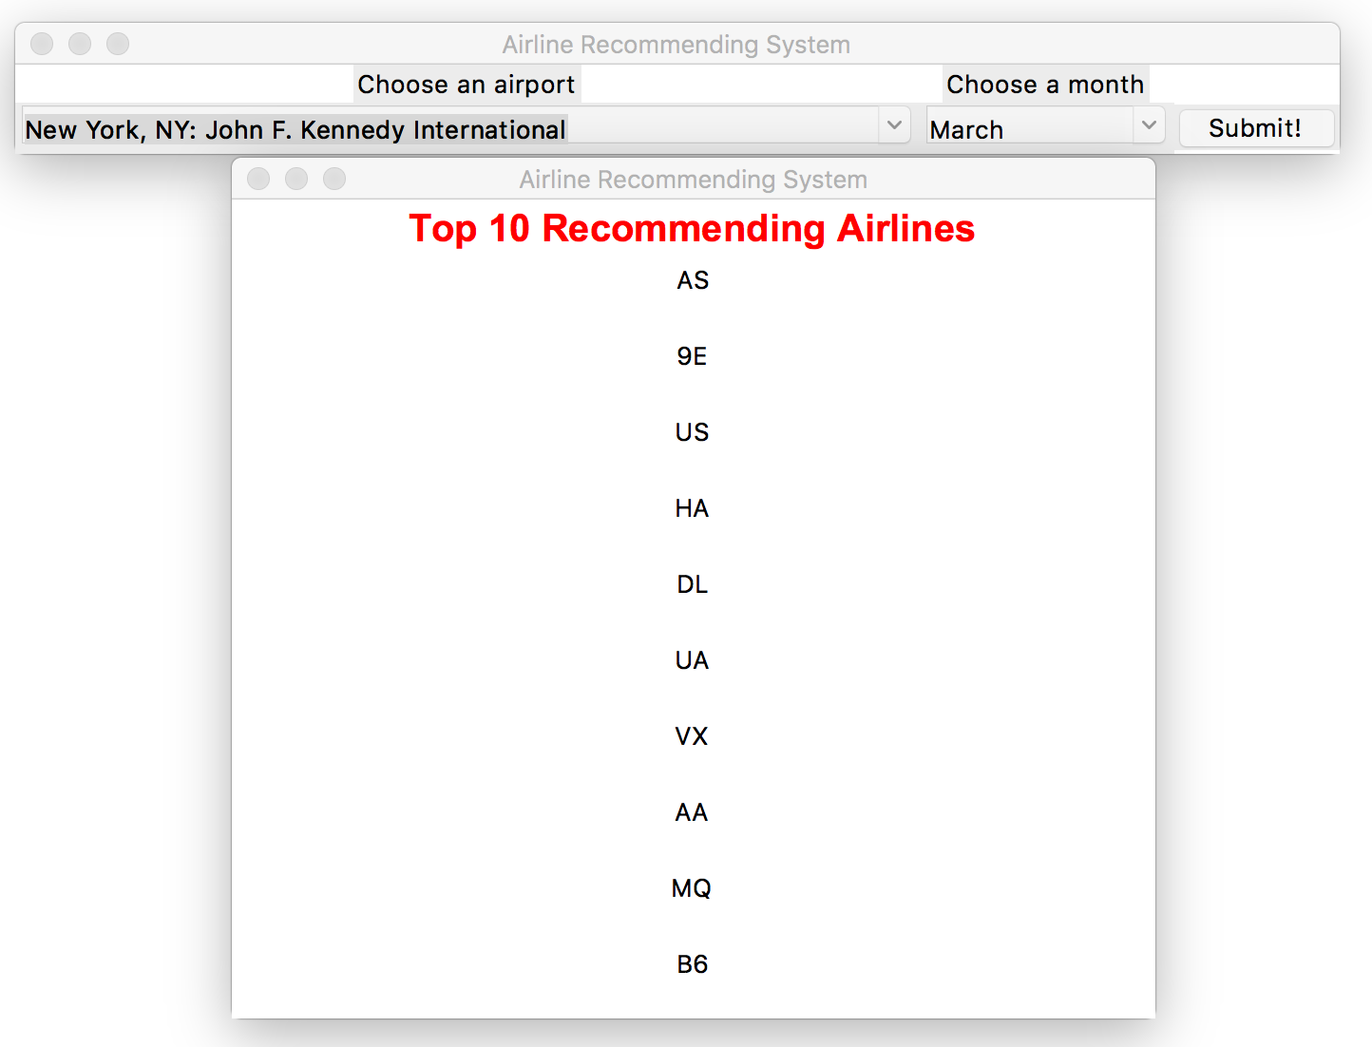
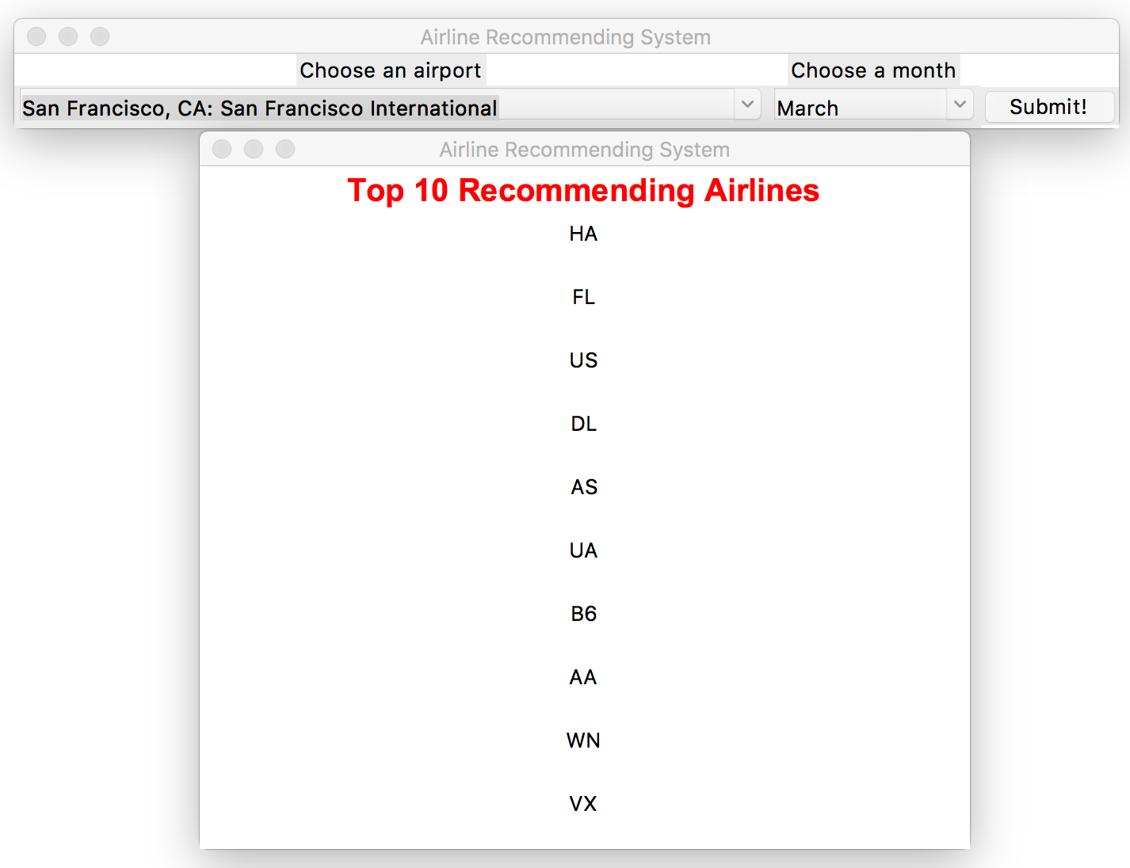
Recommending Results from the System

